Slide 1
Request to Speak
How to make a “Request to Speak” using the
Arizona Legislative Information System
(ALIS)

Slide 2
ALIS stands for:
Arizona Legislative Information System
You may access ALIS from your home computer and portable devices.

Slide 3
ALIS website homepage allows you to:
Use the Request to Speak.
Track Legislation on specific bills.
Know when a bill will be heard in a Committee.
Watch hearings as they are happening.
Find and contact your Legislators.
Learn about the legislative process.

Slide 4
Pursuant to statute section 41-1101, the legislature shall assemble at the seat of government at twelve o'clock noon on the second Monday of January each year. RTS will be fully functional when the bills have been assigned to committees.
Before you can use the RTS you have to be signed up for it. I or someone who is going to the State Capital can do this for you at kiosk located there.

Slide 5
What is Request to Speak?
The Request to Speak application allows you to sign in, register your opinion and leave a comment for the committee members. You do not have to speak to give your opinion to the committee.

Slide 6
This is the website where you can access the RTS system.
www.azleg.gov
Any comments or testimony become part of the permanent record and follow the bill through the legislative process.

Slide 7
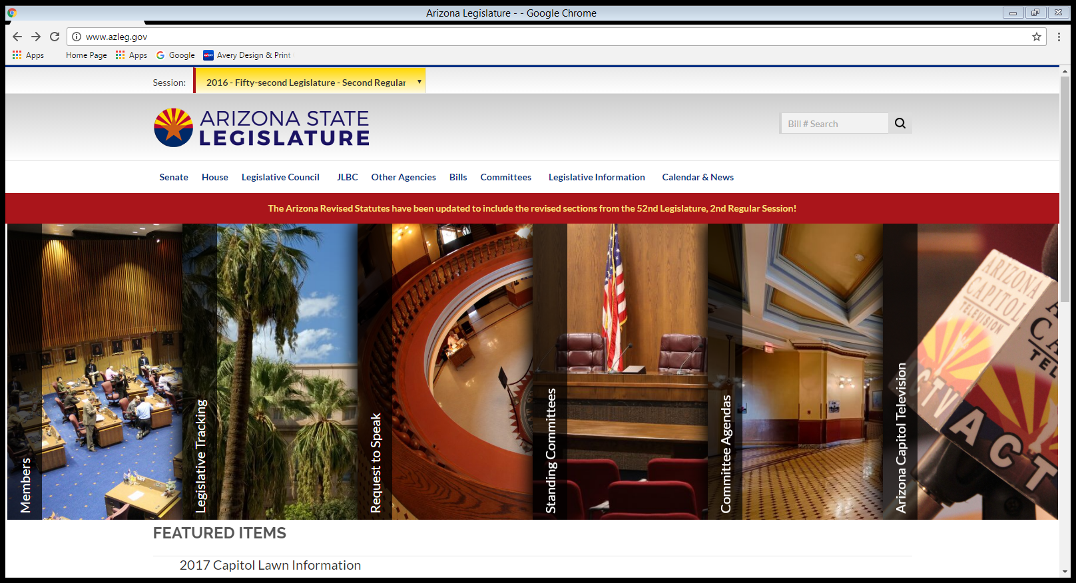
Home Page View
www.azleg.gov

Slide 8
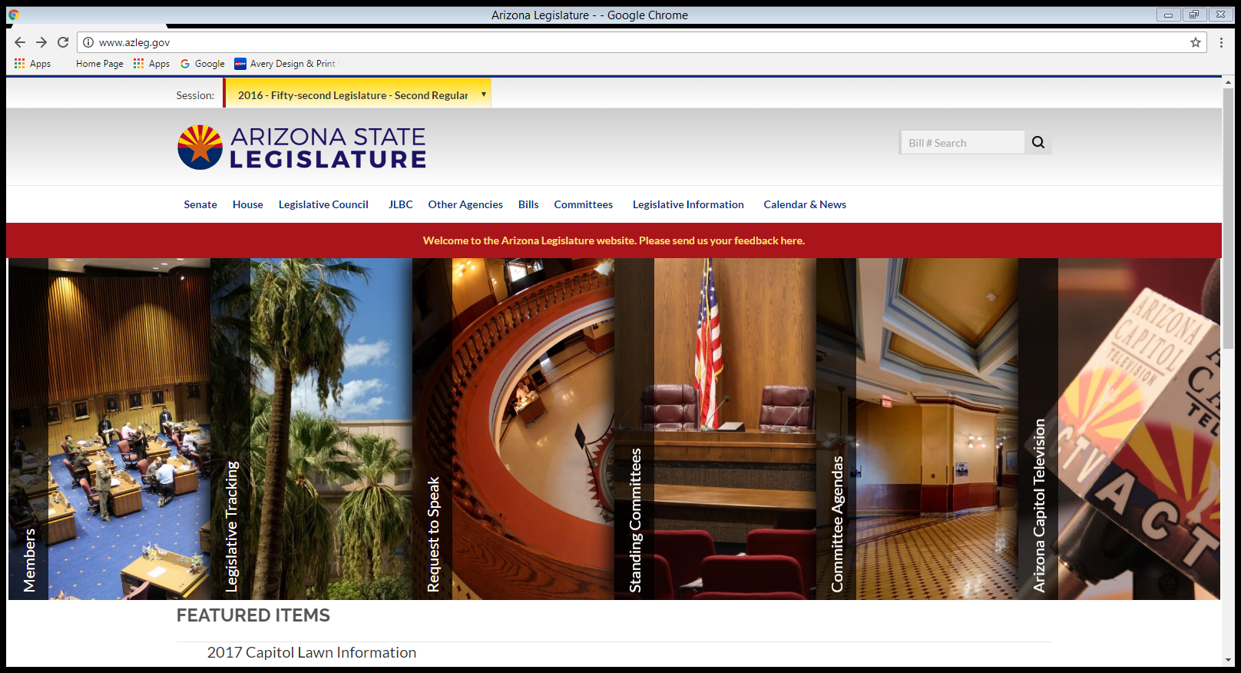
Before you Request to Speak
if you would like to look up a
bill to learn more about it
you can do that here.

Slide 9
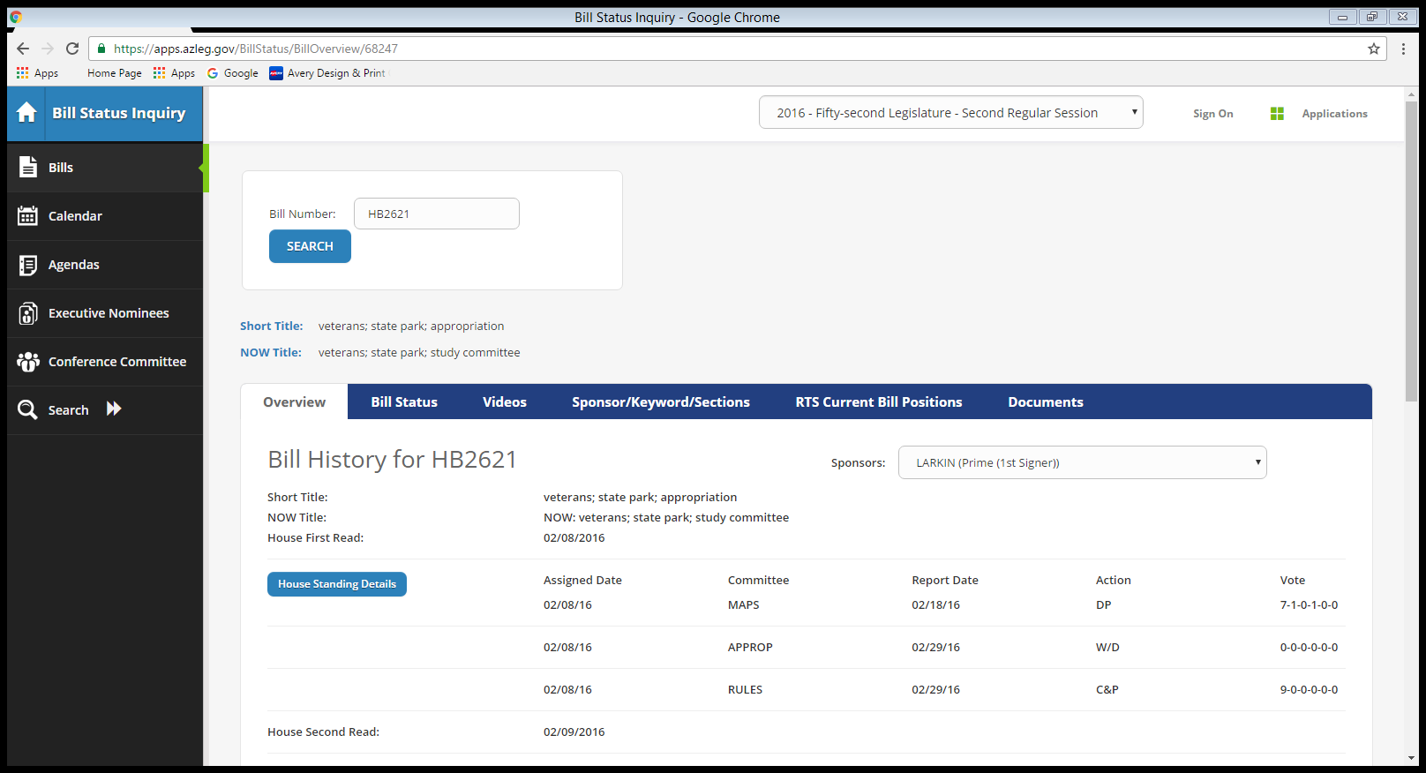
All of the bills information will be on this page.

Slide 10
Once you have looked up a bill you go back to the home page. Then to comment on a bill in writing or in person, you must first click on “Request to Speak”

Slide 11
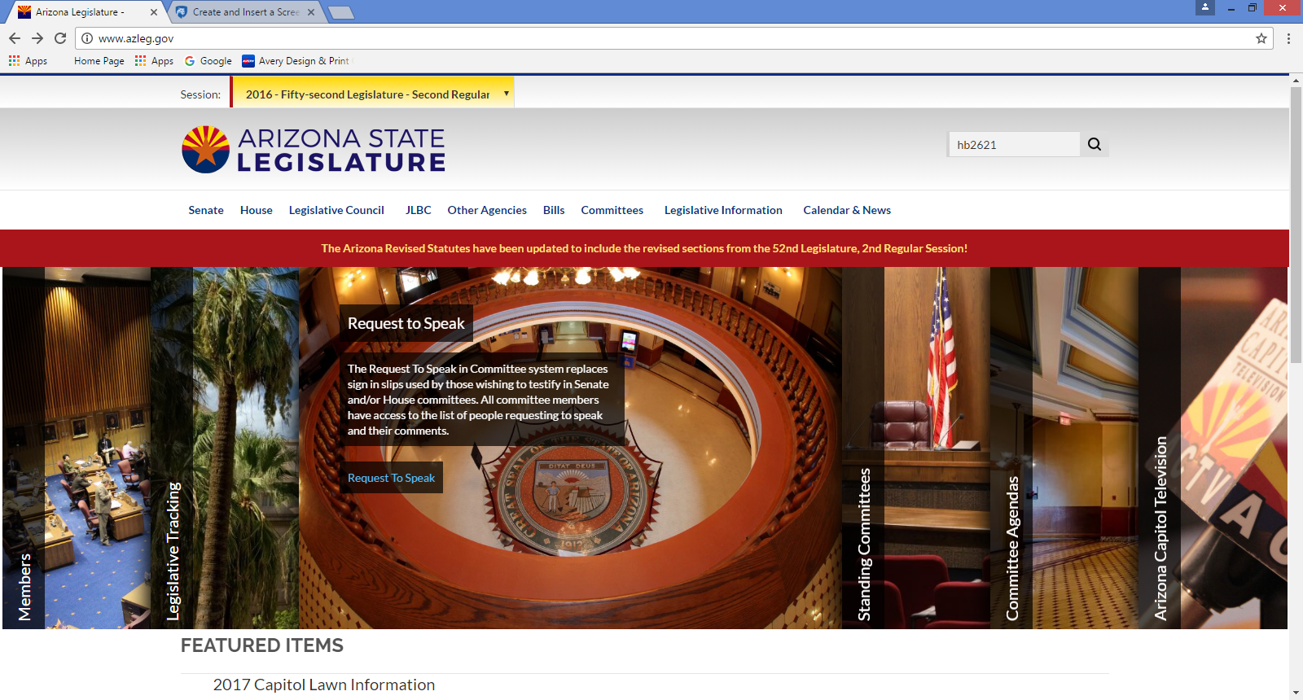
Click on
“Request to Speak”

Slide 12
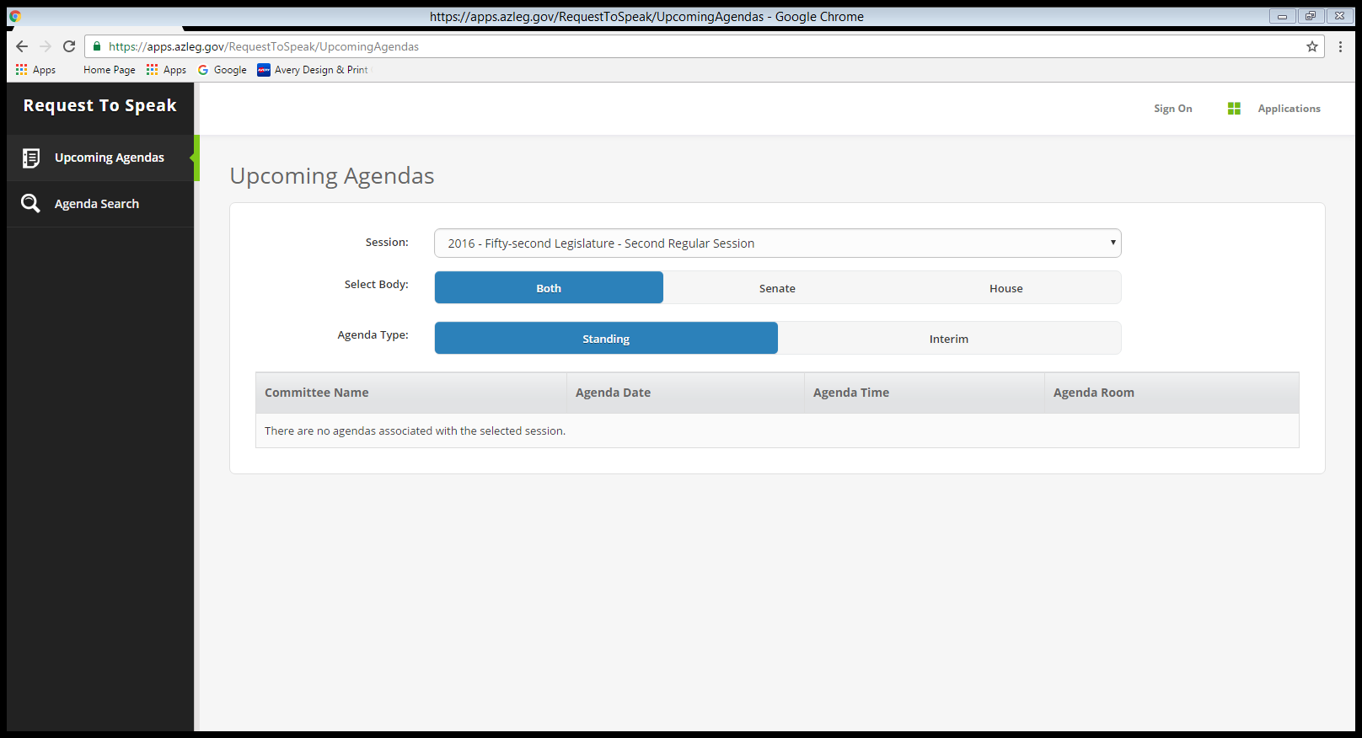
Click on “Request to Speak” or “Sign On”

Slide 13
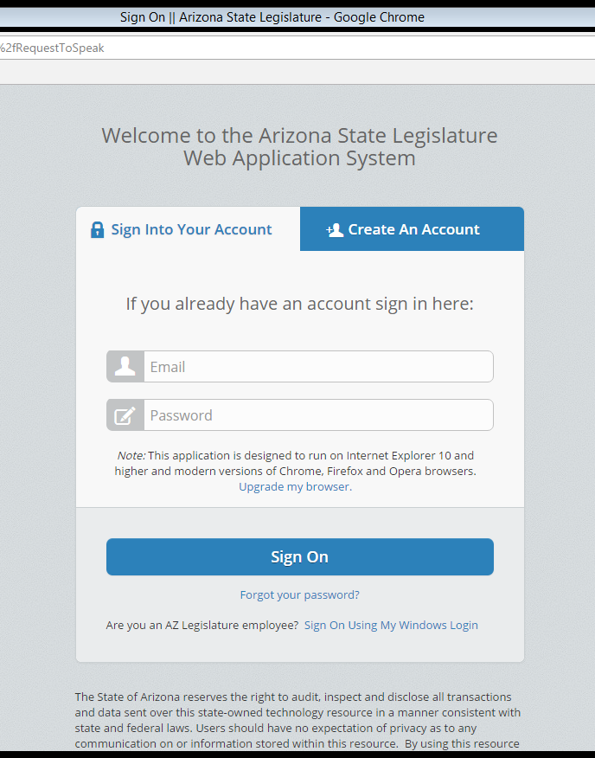
Sign in Page or Create An Account
If you have a account sign.
Enter your account email and password.
If you don’t have a account you can create one.

Slide 14
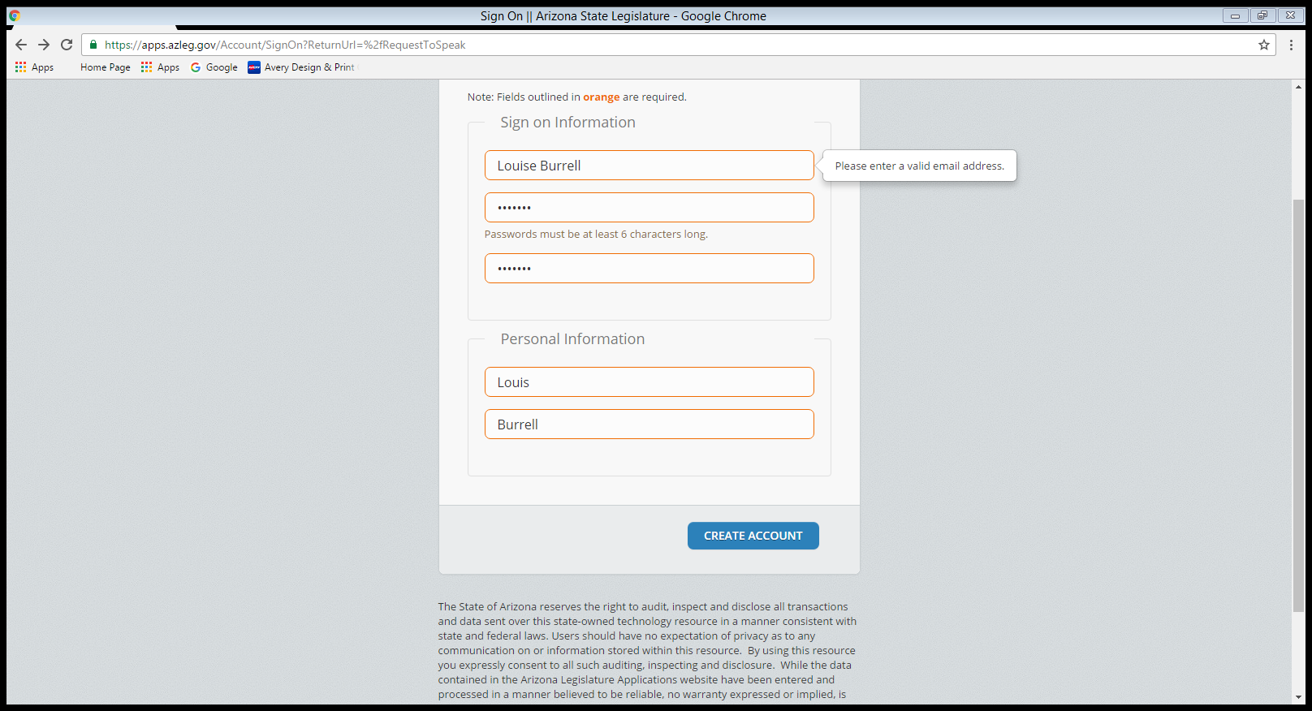
Fill in all of the fields and create account.

Slide 15
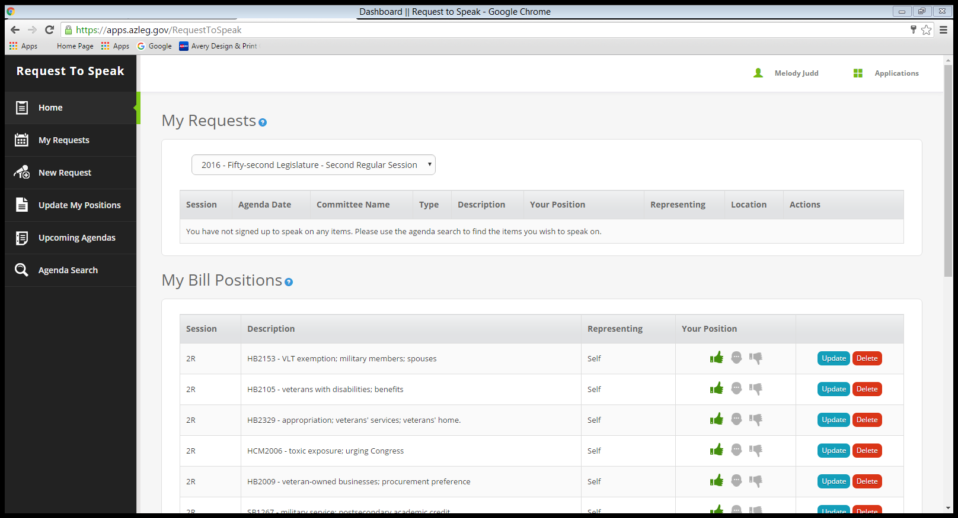
Click on “New Request”

Slide 16
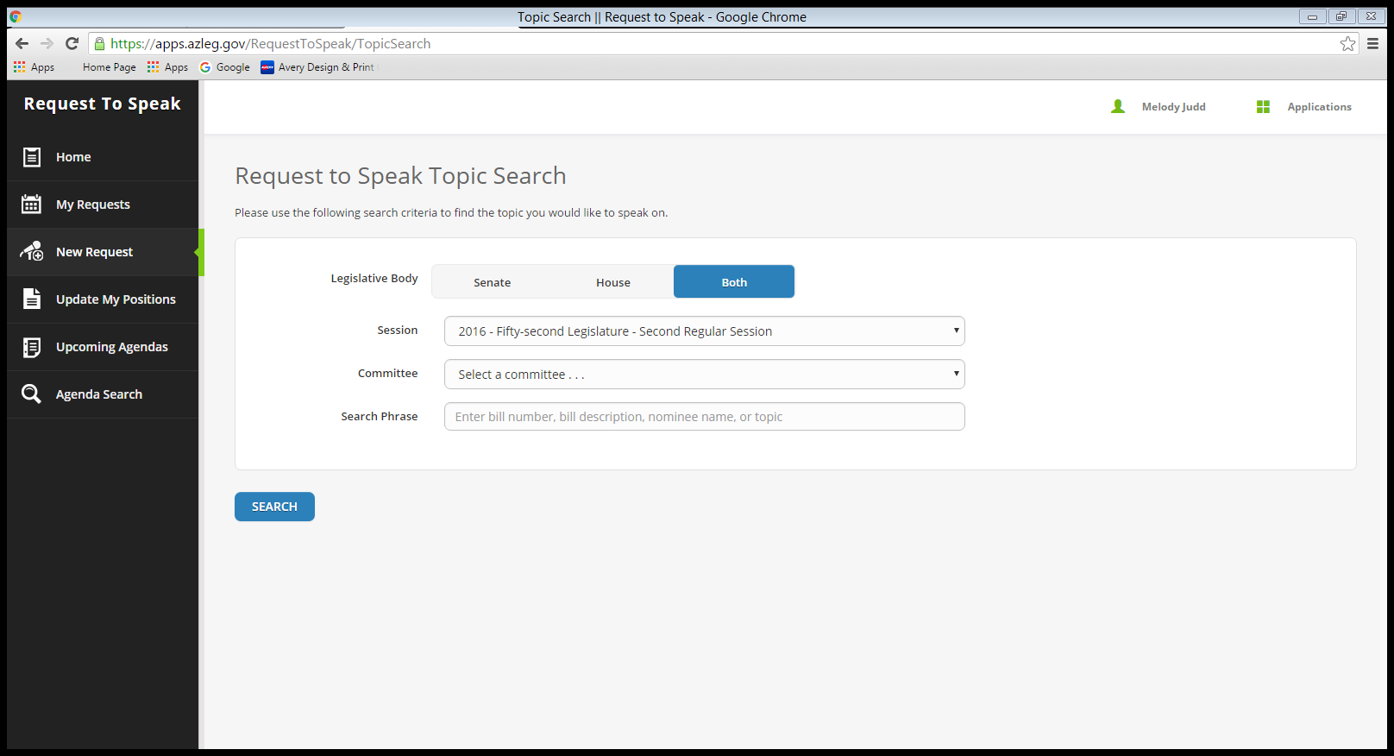
The “New Request” allows you to create a “Request to Speak” on a bill on the current agenda.
Enter the bill number, bill description, nominee or topic here and press search.

Slide 17
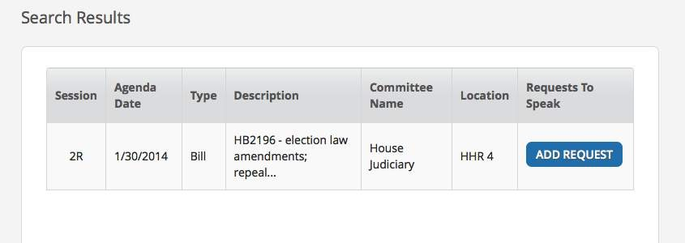
If you've entered accurate information, a result will come up, as below. Click on “Add Request”.

Slide 18

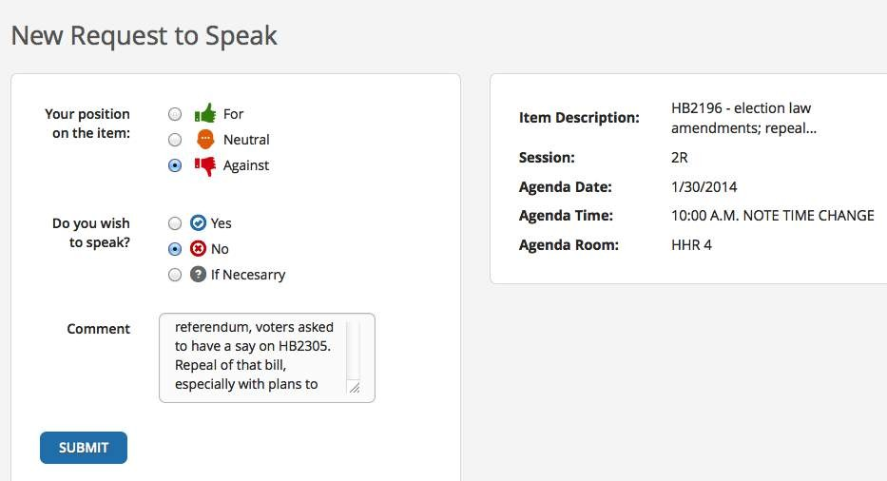

Slide 19
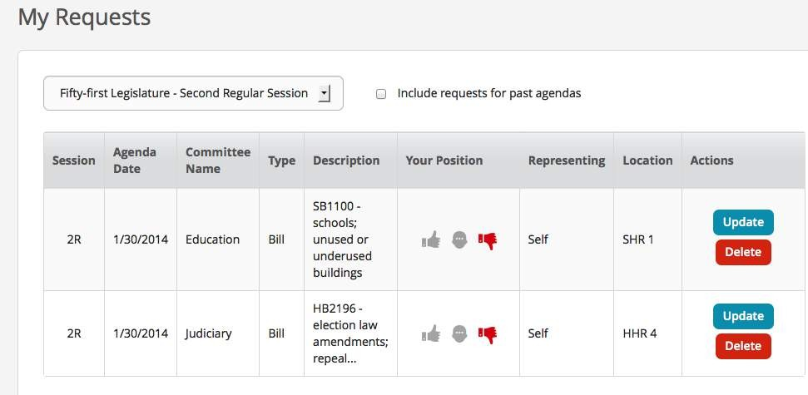
Once submitted, your request will be added to any others you have made.

Slide 20
During committee hearings, the committee chair and members will be able to see your position and any comments, and whether you want
to provide in-person testimony.

Slide 21
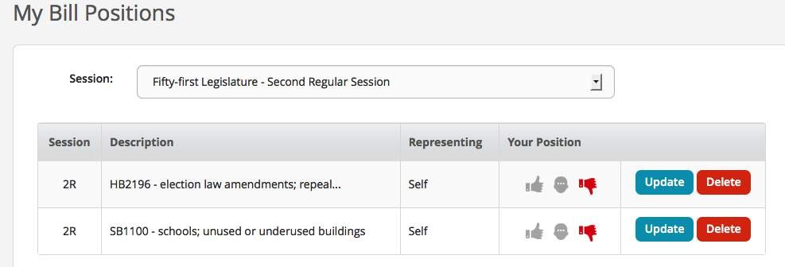
You will also find a copy of your position under the "My Bill Positions" and on the "Home" sections of "Request to Speak"

Slide 22

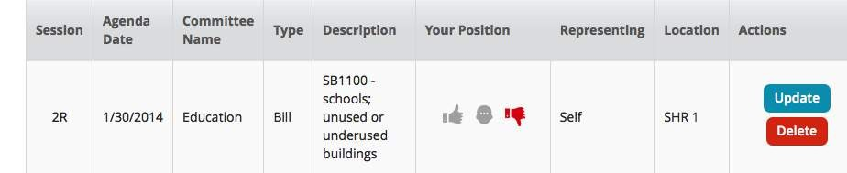

Slide 23
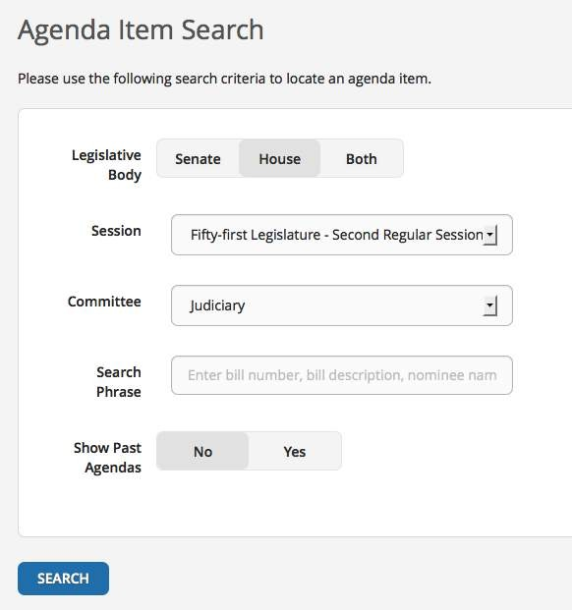
You will notice that from the "Request to Speak" Home page, you may also search for agendas.

Slide 24
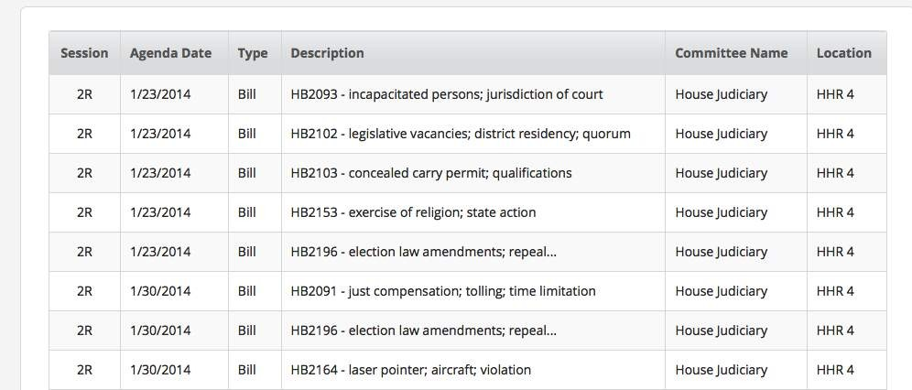
You can see all the bills on the agenda for a given hearing date.

Slide 25
Every benefit that a Veteran and their Family receives starts with legislation!
Request to Speak (RTS) is a effective way for the VFW and Auxiliary to advocate for Veterans and their Families.
I hope that you will make your voice heard at the Arizona Legislature.
There's a lot more you can do with the ALIS system.
The best way to learn is to go to www.azleg.gov and start experimenting!

