Slide 1

LOCAL AUXILIARY
TRUSTEES TRAINING

Slide 2
Auxiliary Secretary
  Per Section 812 of Bylaws – Auxiliary Secretary keeps in books or files:
    Record of all minutes of each meeting
      Each page shall be numbered consecutively & provide a space for Trustees to sign/initial and date
      Treasurer’s reports & audit reports must be in minutes
      Corrections are made in margins
  What should be in the minutes regarding the audit?
    A copy of the President & Treasurer bond
    Copies of Treasurer’s Report
    Presentation of Bills for payment at each meeting
    Copies of prior Audits

Slide 3
Auxiliary Treasurer
Per Section 813 of Bylaws the Auxiliary Treasurer is Treasurer of all committees handling funds
All funds shall be accounted for by the Treasurer in the VFW Auxiliary books, which consist of:
    Ledger
    Cash book
    Or computerized system
    Must be printed and secured in a permanent record book

Slide 4
Auxiliary Treasurer
Collects all money due
Give receipt for all cash
Tracks all other receipts
Writes and signs checks as vote on
Submits all forms necessary to be in compliance with Federal & State regulations
  Tax exempt status compliance (tax return filing)
Notes:
Refer to the name change spreadsheet

Slide 5
Auxiliary Treasurer
Per Section 813A of Bylaws:
  Hold all funds & securities in a FDIC or equivalent banking institution
  Auxiliaries shall have a General Fund and Relief Fund and any other funds needed. Money for all funds shall be maintained in 1 checking account (unless state law requires differently)
  General Fund contains unrestricted monies that may be expended for any purpose voted upon
  The other funds contain restricted funds, which may only be expended for the purpose in which they were received
  By vote of the Auxiliary body, may have savings and investments accounts

Slide 6
Auxiliary Treasurer
Auxiliaries may not possess a credit card
By vote of the Auxiliary body, may possess a debit card to make payments for Auxiliary business purposes only
  Treasurer shall possess the debit card
  Debit cards cannot be used for cash advances
By vote of the Auxiliary body, may accept payment by credit and/or debit card using a third-party processor

Slide 7
Auxiliary Treasurer
Auxiliary bills may not be paid electronically
  Except for monies transferred to National HQ
  Except for the purpose of paying taxes
By vote of the Auxiliary body, may accept payment by credit/debit card using a third-party processor

Slide 8

Auxiliary Treasurer’s Report
At each Auxiliary meeting, the Treasurer shall make a report following the reading of the minutes
The Auxiliary Treasurer’s Report shall contain:
  Balance on hand as of the last report (Beginning Balance)
  Amount of funds received from all sources since the last report
  Amount expended since last report
  Balance on hand (Ending Balance)
  The report shall show all receipts and disbursements in detail, including the name of the person or organization to whom the check is issued and stating for what purpose

Slide 9

Trustees and Audits
  Per Sections 802 & 804 of Bylaws:
    Each Auxiliary and District shall have 3 elected Trustees
    Trustees shall serve a term of 3 years
    One Trustee will be elected at the time Officers are elected each year
    Each Auxiliary, County Council, and District will have:
    A One Year Trustee. The One Year Trustee (also known as Senior Trustee) will serve as the Chairman of the Trustees (has 1 year remaining to serve as Trustee)
    A Second Year Trustee (has 2 years remaining to serve as Trustee)
    A Third Year Trustee (has 3 years remaining to serve as Trustee)

Slide 10
Trustees and Audits
Duties of Trustees (Sec 814 Bylaws)
  All audits are to be completed by Trustees
  Properly audit the books and records of the VFW Auxiliary Treasurer and Secretary
  Complete the audit and forward an accepted and signed copy of the audit to the Department Treasurer

Slide 11
Trustees and Audits
A minimum of 2 Trustees are to attend an audit (at least 1 must be an elected Trustee)
  Under extenuating circumstances, a pro tem Trustee can be appointed by the President to audit the books
  Should a Trustee resign, move away, etc. the VFW Auxiliary will elect a member to fill the un-expired term of that particular Trustee

Slide 12
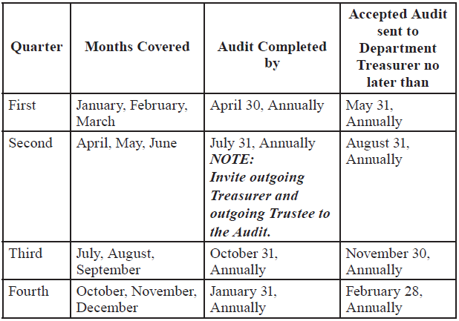
Trustees and Audits
  Sign/initial and date all pages attached to record books of Secretary and Treasurer at the time of the audit
  Submit and read the written audit report during a VFW Auxiliary meeting.

Slide 13
Trustees and Audits
  Verify all expenditures of the VFW Auxiliary and certify by their signatures to the correctness of each bill before payment may be made
  Shall audit the records and accounts of all committees, Officers and members having to do with the receipt and expenditure of the VFW Auxiliary funds and perform such other duties incident to their office as the VFW Auxiliary may direct or the law require
    990-N ePostcard filing, 8822-B filing, other tax forms

Slide 14
Trustees and Audits
  Review, date and sign/initial statements containing reports of the debit card transactions every month to ensure that all debit card purchases were made in accordance with votes of the Auxiliary and/or standing rules
  If the Auxiliary voted to accept payment by credit and/or debit card, record of transactions must be provided to the Trustees at each audit

Slide 15
Trustees and Audits
  See that the offices of President and Treasurer are bonded with an indemnity company authorized by National HQ or the Department
    The bond must be in a sum at least double the amount of funds and value of property for which, so far as can be anticipated, the President and Treasurer may be accountable
    The amount of the bond shall be approved by the body and bond premium paid from their funds
    The office of President shall hold the original bond of both offices
    A copy of the bond shall be incorporated into the minutes each year.

Slide 16
Trustees and Audits
Negligence on the part of the Trustees in carrying out the mandates of Section 814 of the Bylaws, or in attending audits, shall make them individually and collectively responsible, with any others, for any discrepancy
Sec 308 of Bylaws - Any VFW Auxiliary in arrears for failure to bond or to make quarterly audits will be deprived of VFW Auxiliary representation on all levels

Slide 17

Preparing for an Audit
Items to have available:
  Permanent record books of the Treasurer and Secretary
  The checkbook
  Any savings books or investments
  Cash receipts book
  Receipts and bills
  Membership records such as Transmittals, Comprehensive Membership Report (CMR), Dues Paid By-Membership Report, Deceased Members Report, Transferred Members Report, and Unpaid Members Report

Slide 18
Preparing for an Audit
  All Treasurer’s Reports given at each meeting
  Minutes of each meeting
  Bank Statements along with cancelled checks
  Statements of transactions from 3rd party processor (if applicable)
  Copy of the most recent audit
    Ending balances of previous audit are beginning balances of current audit
  Copy of Standing Rules (if applicable)
  Blank Audit Forms

Slide 19
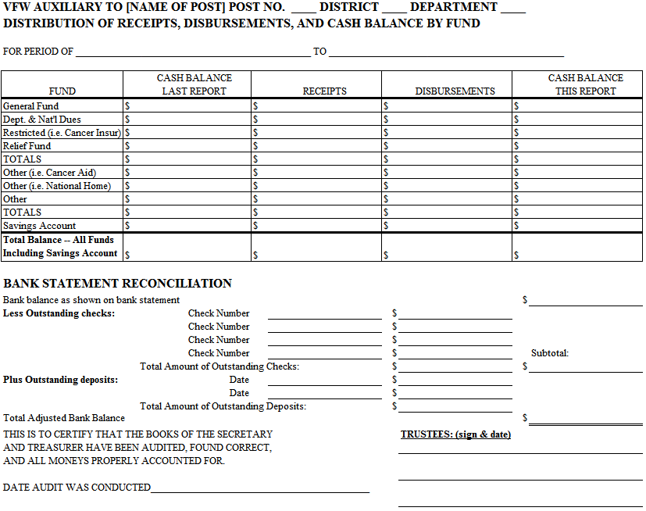

Slide 20
Performing an Audit
  Review and check Treasurer’s book against the checkbook to ensure all receipts and expenditures are listed
    Cash receipt book transactions in Treasurer’s book
    Receipts in Treasurer’s book = deposits
    Expenditures in Treasurer’s book = checks written
  Reconcile Bank Statements
    Review cleared transactions and compare to checkbook and Treasurer’s book
    List outstanding checks or debit card transactions (checks which have not yet cleared the bank) by check number and amount
    List outstanding deposits by date and amount
    Balance of bank statement + outstanding deposits – outstanding checks = balance of check book

Slide 21

Performing an Audit
  Review and check Secretary’s minutes to ensure that all expenditures other than membership transmittals were either authorized by a motion or are in the VFW Auxiliary’s standing rules.

Slide 22

Performing an Audit
  Compare Auxiliary dues against National’s reports
    Ensure that every member that pays dues shows as paid in National’s reports!

Slide 23

Performing an Audit
  Trustees must report, not correct, any errors found (“Findings”) on the audit report or a separate sheet attached to the audit report

Slide 24

Performing an Audit
  Suggested Tasks for 1st Year Trustee (Chairman)
    Review the checkbook against withdrawals and deposits
    List outstanding checks or debit card transactions by check number & amount; list outstanding deposits by date & amount for inclusion on audit report form
    Reconcile bank statement with the checkbook
    Reconcile all dues against National membership reports
    Read totals from previous audit as beginning balances of current audit
    Sign/initial reverse side of last checkbook stub, last receipt stub, last bank statement, 3rd party processor statement (if applicable) and Secretary’s book and Treasurer’s book
    Review, date, and sign the completed audit form

Slide 25

Performing an Audit
  Suggested Tasks for 2nd Year Trustee
    Review and check the bank statement and cleared transactions to match expenditures
    Review and check the deposits and compare with receipts
    Review statements from 3rd party processor (if applicable) and compare with deposits
    Total all receipts; total all disbursements and calculate new cash balance
    Read totals to 1st Year Trustee for incorporation into audit form
    Ensure that all appropriate tax forms have been filed (990-N ePostcard, Form 8822-B, bingo licensing, etc.)
    Sign/initial reverse side of last checkbook stub, last receipt stub, last bank statement, 3rd party processor statement (if applicable) and Secretary’s book and Treasurer’s book
    Review, date, and sign the completed audit form

Slide 26

Performing an Audit
  Suggested Tasks for 3rd Year Trustee
    Read from Treasurer’s book receipts and expenditures
    Review Secretary’s minutes for authorization of expenditures (except for membership transmittals and expenditures authorized by standing rules)
    Prepare the audit report form on basis of information from other Trustees
    Sign/initial reverse side of last checkbook stub, last receipt stub, last bank statement, 3rd party processor statement (if applicable) and Secretary’s book and Treasurer’s book
    Review, date, and sign the completed audit form
    Mail a copy of the completed audit to the Department Treasurer after it has been accepted by motion as read at a VFW Auxiliary meeting

Slide 27
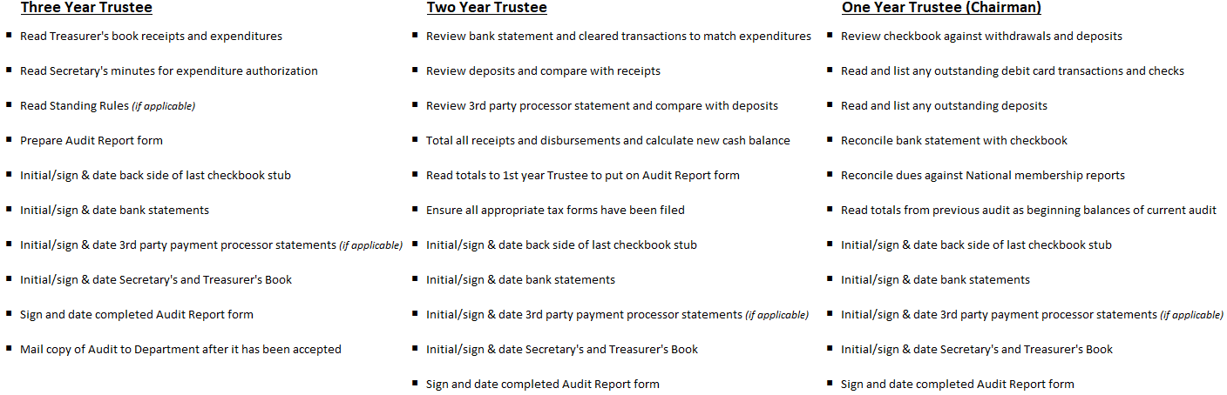
Performing an Audit

Slide 28
Performing an Audit
  Trustees prepare and sign the audit report
    The Treasurer does not prepare the audit report!
  A copy of the accepted audit must be given to the Secretary for incorporation into minutes
  The audit should be conducted in an environment conducive to conducting business
  The President, Treasurer, and Secretary should attend the audit – not perform the audit!
    At the 2nd quarter audit meeting the outgoing Treasurer and incoming Treasurer should attend the audit

Slide 29
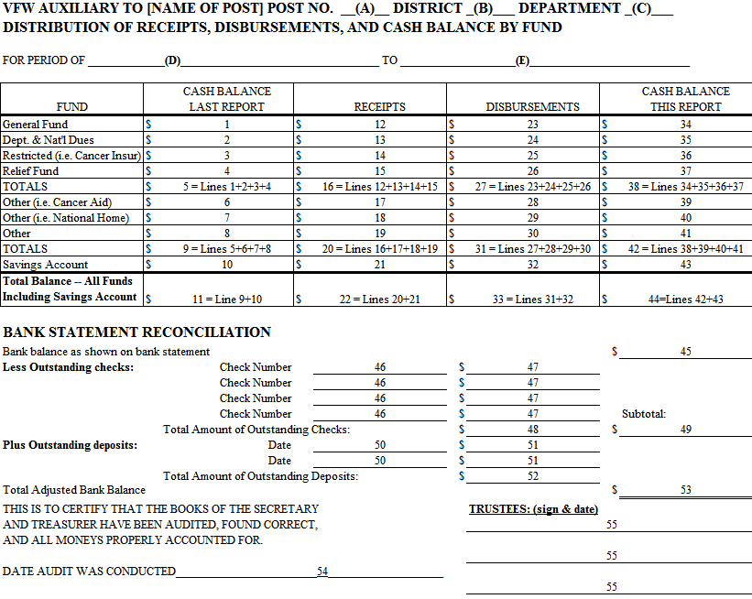
Performing an Audit

Slide 30
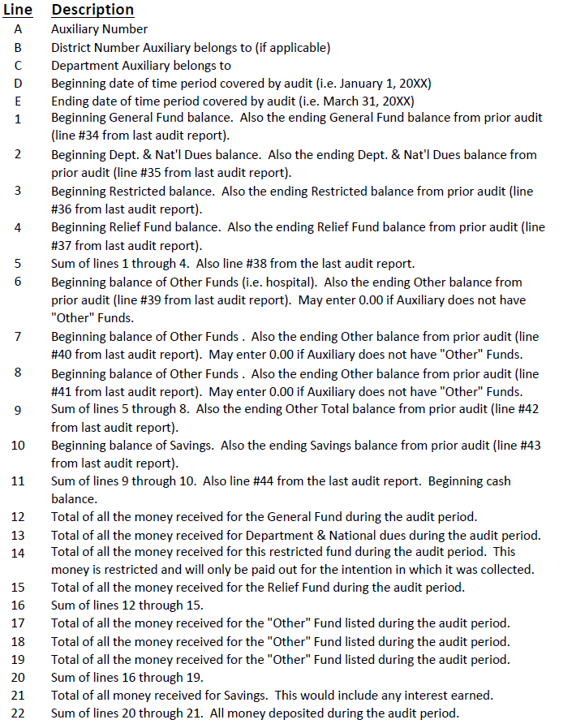
Performing an Audit

Slide 31
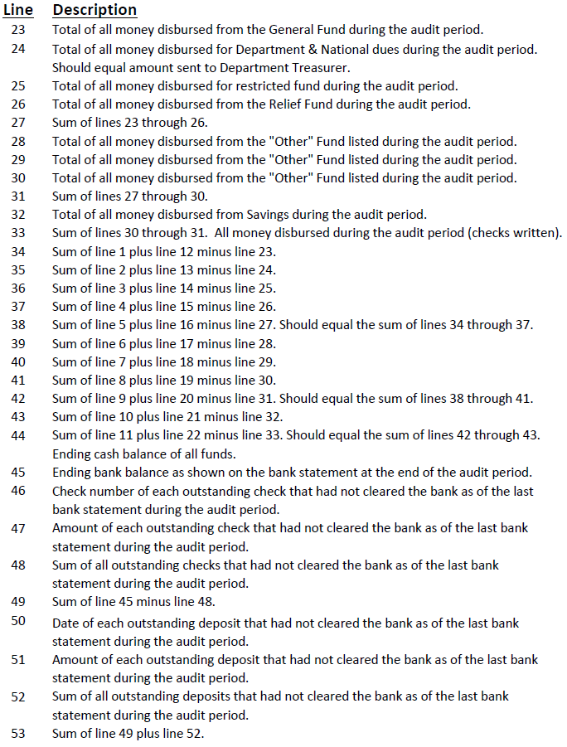
Performing an Audit

Slide 32

Performing an Audit

