Slide 1

VFW Auxiliary Outreach Overview
Department of Arizona

Slide 2
Definition and Importance
What is Auxiliary Outreach?
Auxiliary Outreach is a partnership formed by a VFW Auxiliary with another organization for the benefit of their community or its institutions. It is a donation of time, not in-kind or monetary donations. It’s about partnering with other organizations in our communities to help improve where we live.

Slide 3
Contents
1. Understanding VFW Auxiliary Outreach
2. What does and does not qualify as an Outreach Program Activity?

Slide 4
1. Understanding VFW Auxiliary Outreach

Slide 5
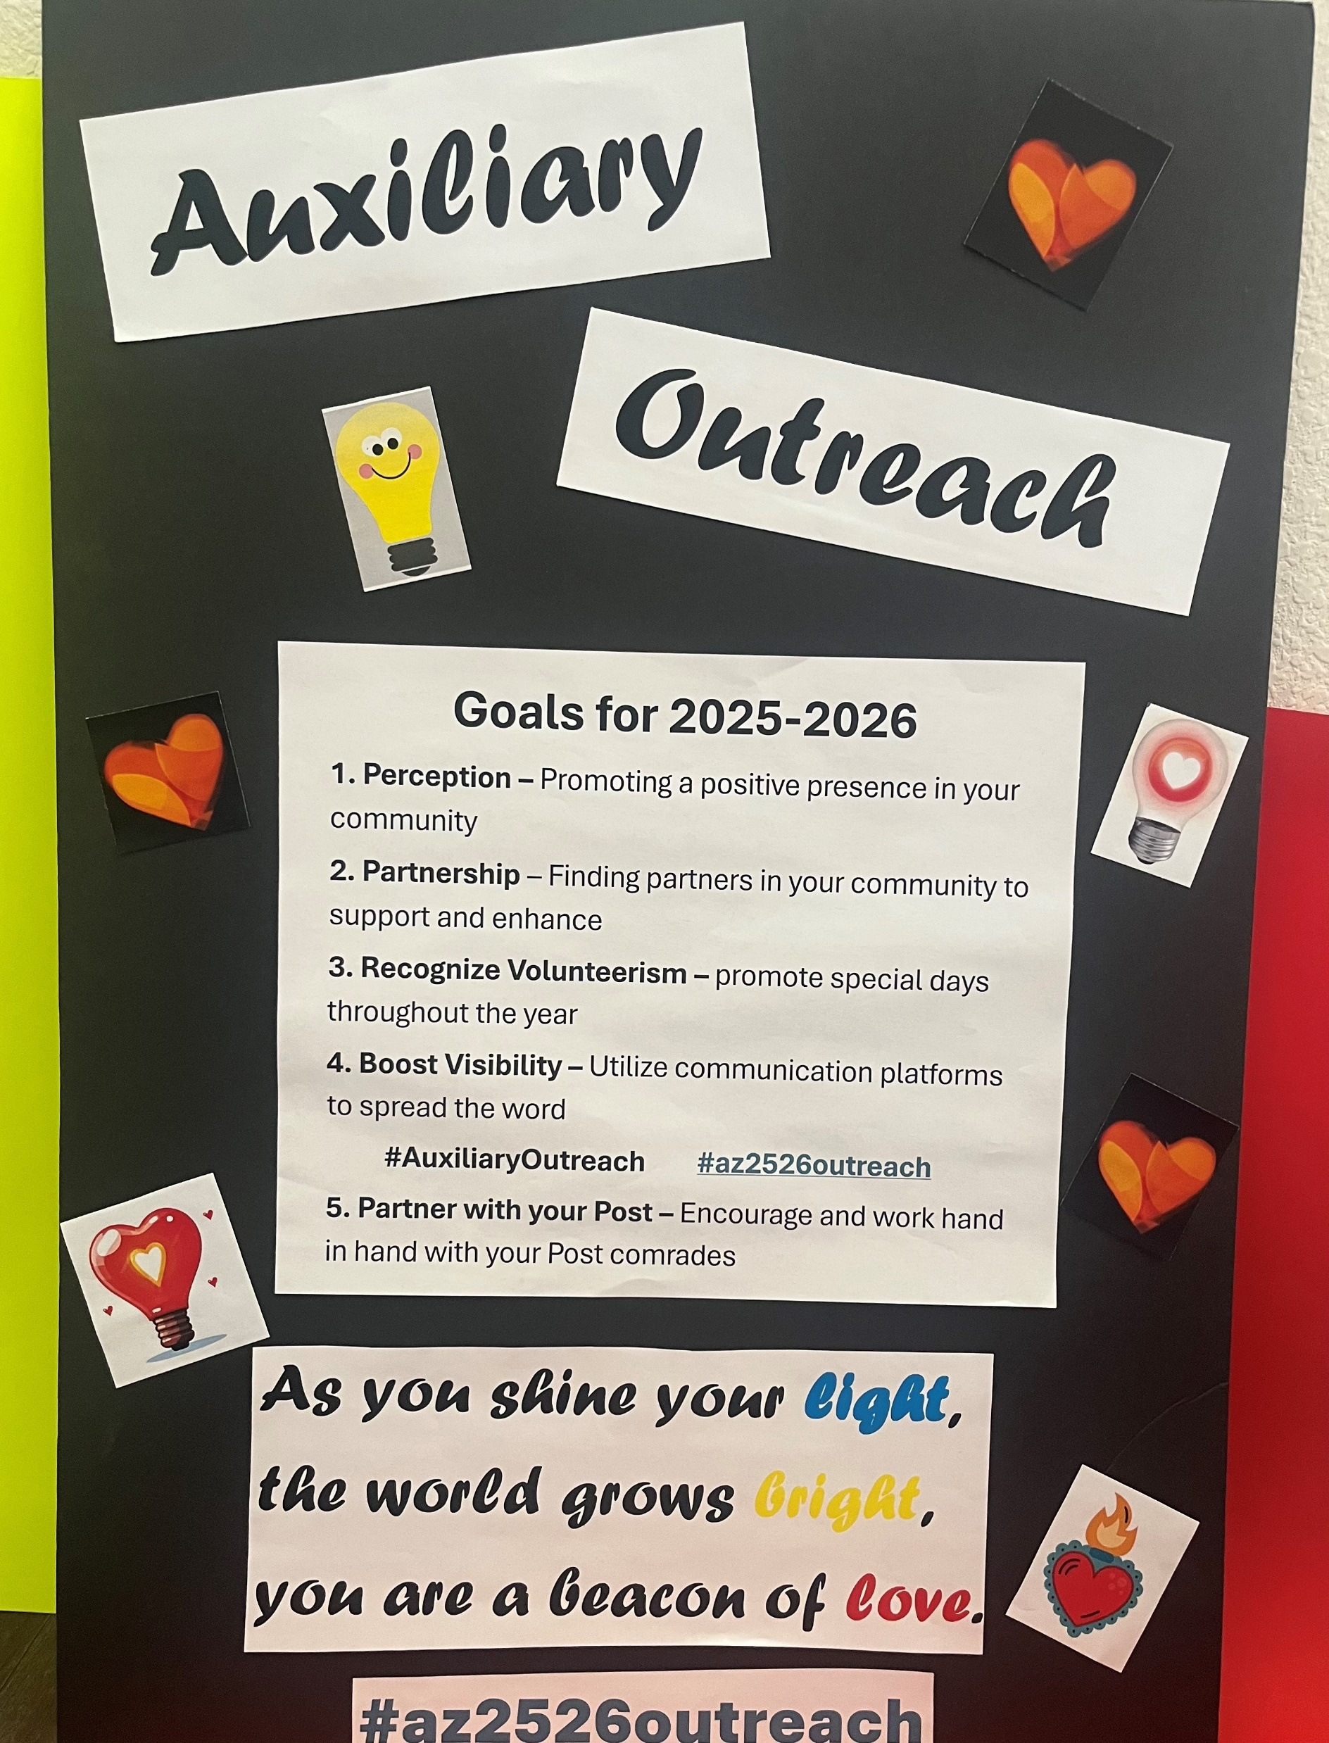
Definition and Goals
Purpose of VFW Auxiliary Outreach
When an entire Auxiliary partners with another organization outside our own, it is considered Auxiliary Outreach if the project was approved by the Auxiliary and recorded in the meeting minutes prior to the project.
Auxiliary Outreach can
• Be performed by people of any age, skill set or ability level.
• Benefit any group of people such as youth, senior citizens and those with disabilities.
• Benefit animals, the environment and public spaces.
• Be done in communities of all types and sizes – rural, suburban and urban, small and large.

Slide 6
Key Activities and Initiatives
Examples of Outreach Programs
Department Theme: Helping the Homeless EXAMPLES
• Working walks or runs that benefit other organizations as an event spotter, water station volunteer, timekeeper, etc. (Walking or running in the race is not part of Auxiliary Outreach; that’s participation, not partnering.)
• Working with local police on child ID kits or with EMTs to host CPR Training.
• Working with firefighters on fire safety and prevention.
• Working with parks and recreation departments to plant trees, develop non-veteran-related
community art installations and on adopt-a-park initiatives.
• Helping with a spay and neuter animal clinic.
Serving food in soup kitchens.
Partnering with a local adult center and helping to distribute blankets made by their participants.
Partnering with a local craft group who has made doggie booties and distribute to homeless in parks who have pets.

Slide 7
2. What does and does not qualify as an Outreach Program Activity?

Slide 8
Definition and Importance
What is Auxiliary Outreach?
Auxiliary Outreach is a partnership formed by a VFW Auxiliary with another organization for the benefit of their community or its institutions. It is a donation of time, not in-kind or monetary donations. It’s about partnering with other organizations in our communities to help improve where we live.
Benefits to Communities
• Be performed by people of any age, skill set or ability level.
• Benefit any group of people such as youth, senior citizens and those with disabilities.
• Benefit animals, the environment and public spaces.
• Be done in communities of all types and sizes – rural, suburban and urban, small and large.

Slide 9

What’s Not Considered Auxiliary Outreach?
Auxiliary Outreach is for projects NOT AFFILIATED with VFW or VFW Auxiliary Programs.
Volunteer work that is performed for the benefit of the VFW Post or VFW Auxiliary is NOT considered Outreach.

Slide 10
As you shine your light, the world grows bright, you are a beacon of love.
Be sure to spread the word about the GREAT things you do to help your communities!
#AuxiliaryOutreach #AZ2526Outreach
Use the above hashtags on Social Media to inspire others, too!
Amy Bennett, AO Department Chairman
“You’ve got a friend in me!”

